Slide 1

SMART ATTENDANCE MANAGEMENT SYSTEM
Under the Guidance - Ms. Sukruti Kaulgud
Group 3 (05, 38, 60)

Slide 2
TABLE OF CONTENTS
Social Problem Identification
Technical Solution
Abstract
Proposed Methodology
05. Future Lens
06. User Lens
07. Organizational Lens
08. Output
09. Outcome

Slide 3
Social Problem Identification
Accuracy of Data
Time Consuming
Accessibility of those Information by the Legitimate Concerned Party

Slide 4
Technical Solution
User-friendly interface for admins to access the attendance database and for non-admins (parents) to check their child's attendance by mailing the attendance
Speed of the attendance recording process is faster
Develop a database for the attendance management system.
2
4
6
1
3
5
7
A portable, handy and self-powered Smart Attendance System
Accurate recognition of face from database
Allow new students or staff to store their faces in the database by using a GUI.
Able to show an indication to the user whether the face- recognition process is successful or not.

Slide 5
Abstract
Main purpose: Build a face recognition-based attendance monitoring system for educational institution to enhance and upgrade the current attendance system into more efficient and effective as compared to before.
In this project:
Registration
Attendance
Reports

Slide 6



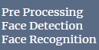
Proposed Methodology
Face Database for Face Recognition
Image Acquisition
1
2
3
4
Image Processing
Marking Attendance

Slide 7
Future Lens
In the project:
Adding login permissions for the students and teachers.
Sending an email notification to the parents and the students who are absent.
Security:
To identify culprits on bus stations, railway stations and other public places.
GSM module: Suppose if culprit is detected, then detected signal can be transmitted using GSM module to the central control room of police station. With the help of ISDN number of GSM, culprit surviving area will be recognized

Slide 8
User Lens
Intelligence Agencies, Police Database (law and order)
Banks
Prisons
Educational Institutes
Commercial and residential buildings
Airpots

Slide 9
Organizational Lens
Students have learned Python in Professional Skills in fourth semester under Holistic Development .They have to yet implement any projects based on Python .
Students are expected to identify a problem based on the same and Implement them as a part of Project based learning .
Same is to be practised for designing the technical solution

Slide 10
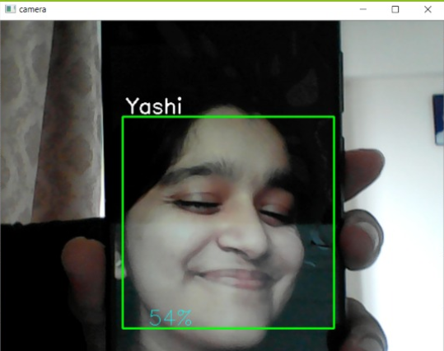
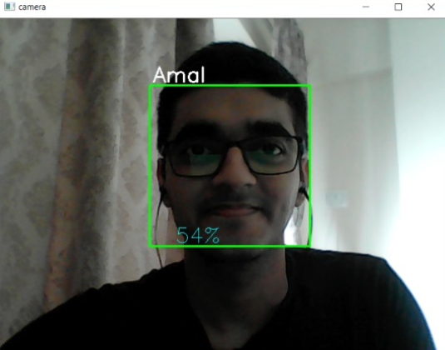
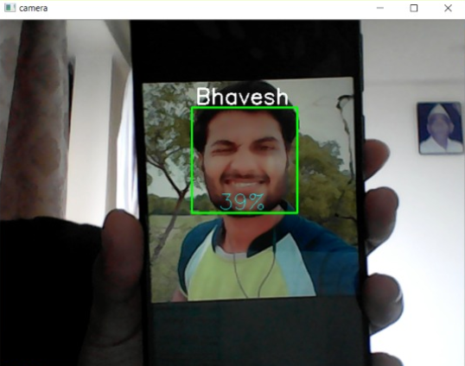
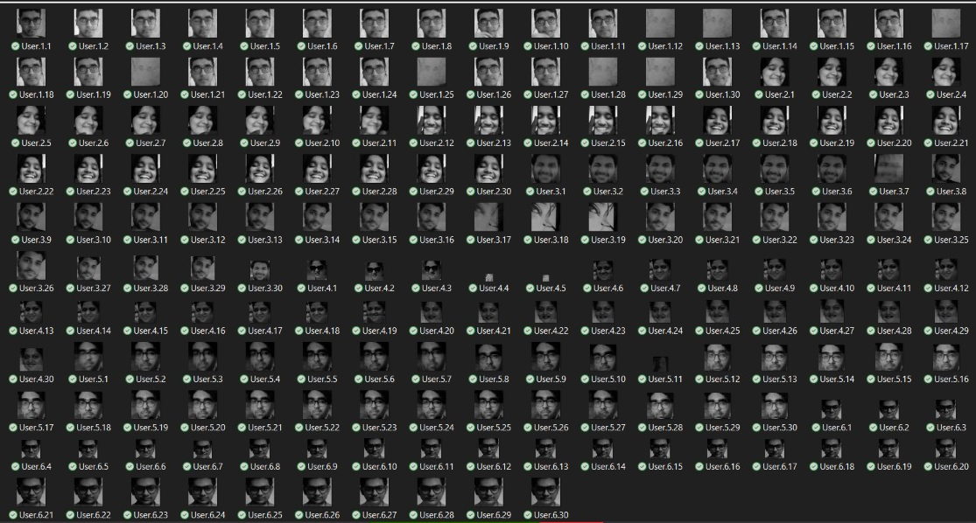
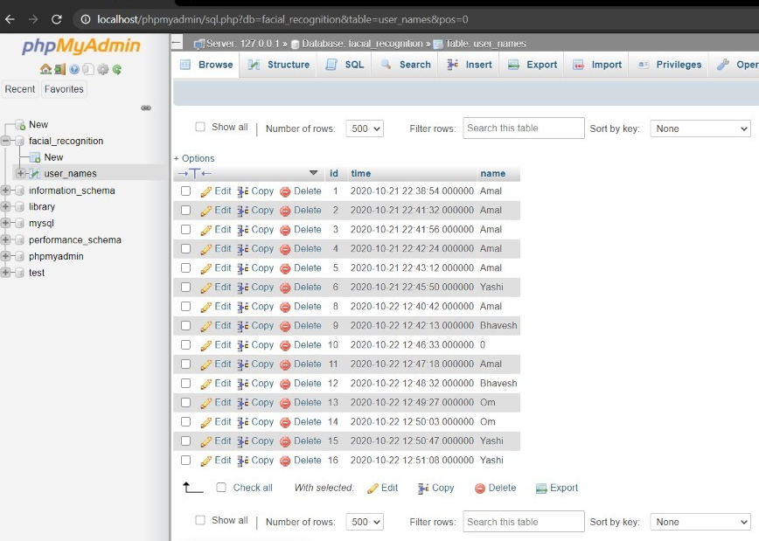
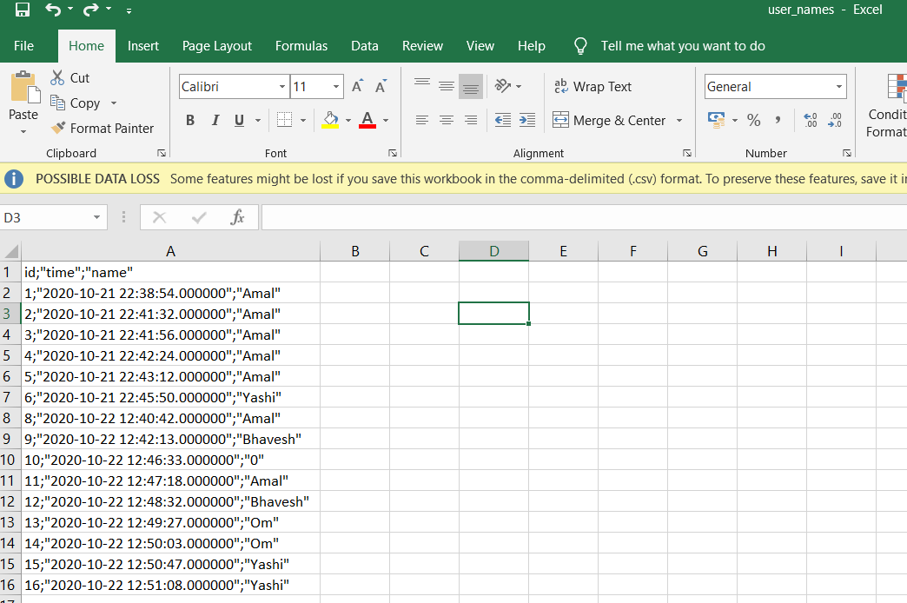
Output

Slide 11
Outcome
The students will be able to:
Synthesis the Problem statement
Foster solutions to explore the design challenge.
Map through activity system as the foundation model to solve Problem.
Understand team members and their roles who determine the success of design challenge.
Frame project into design opportunity
Identify, select and invite your target stakeholders for the interview
Plan outline of project management

Slide 12
Thank You

